Slide 1
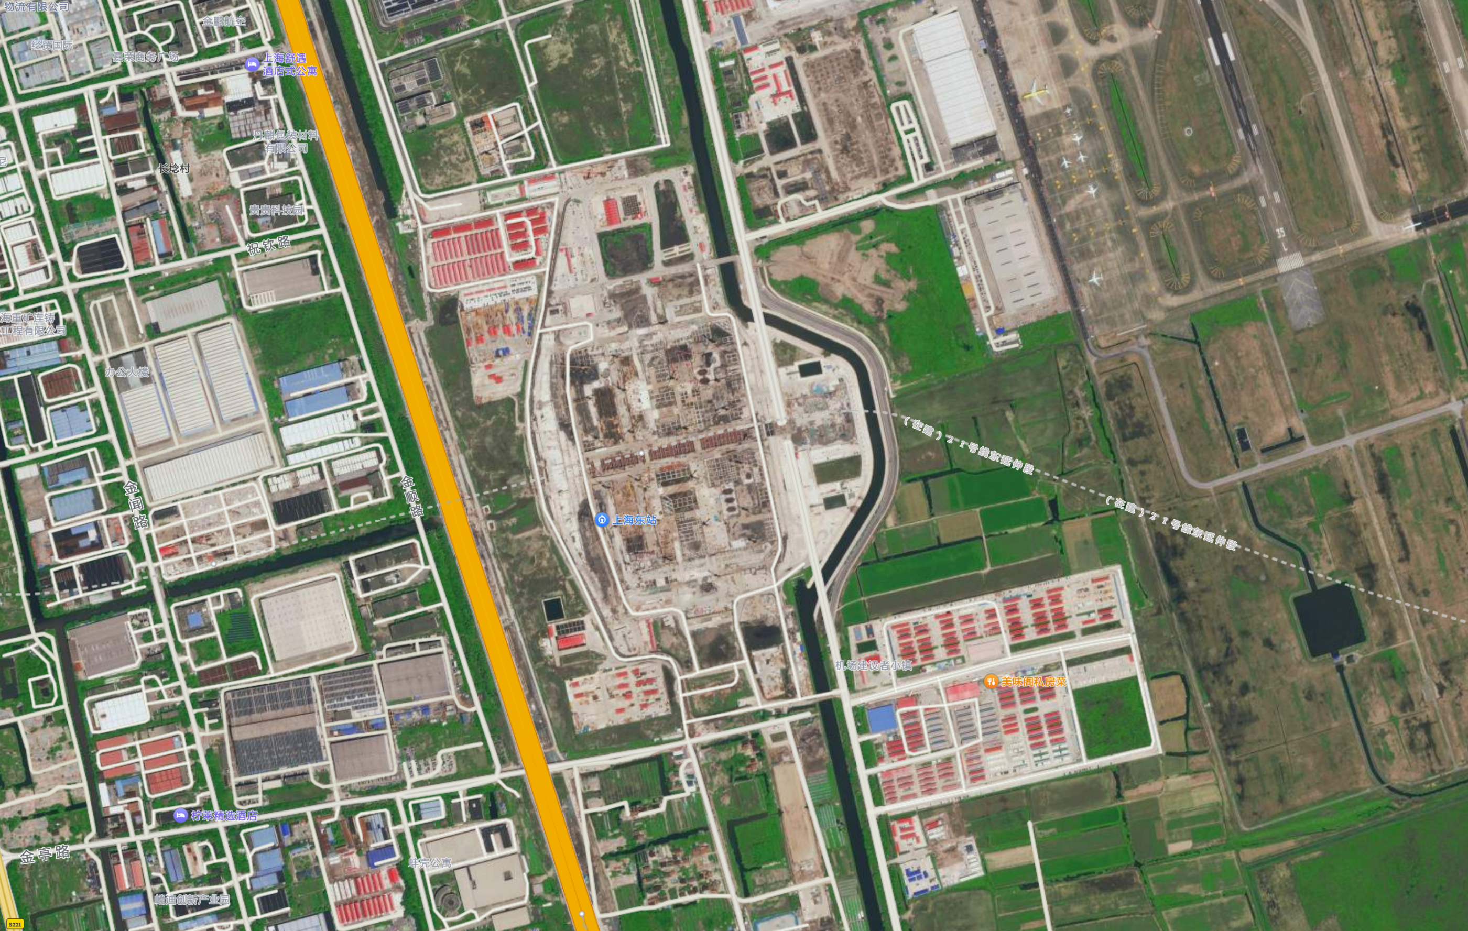
Airport area
Residential area
Slope
Important roads nearby

Slide 2
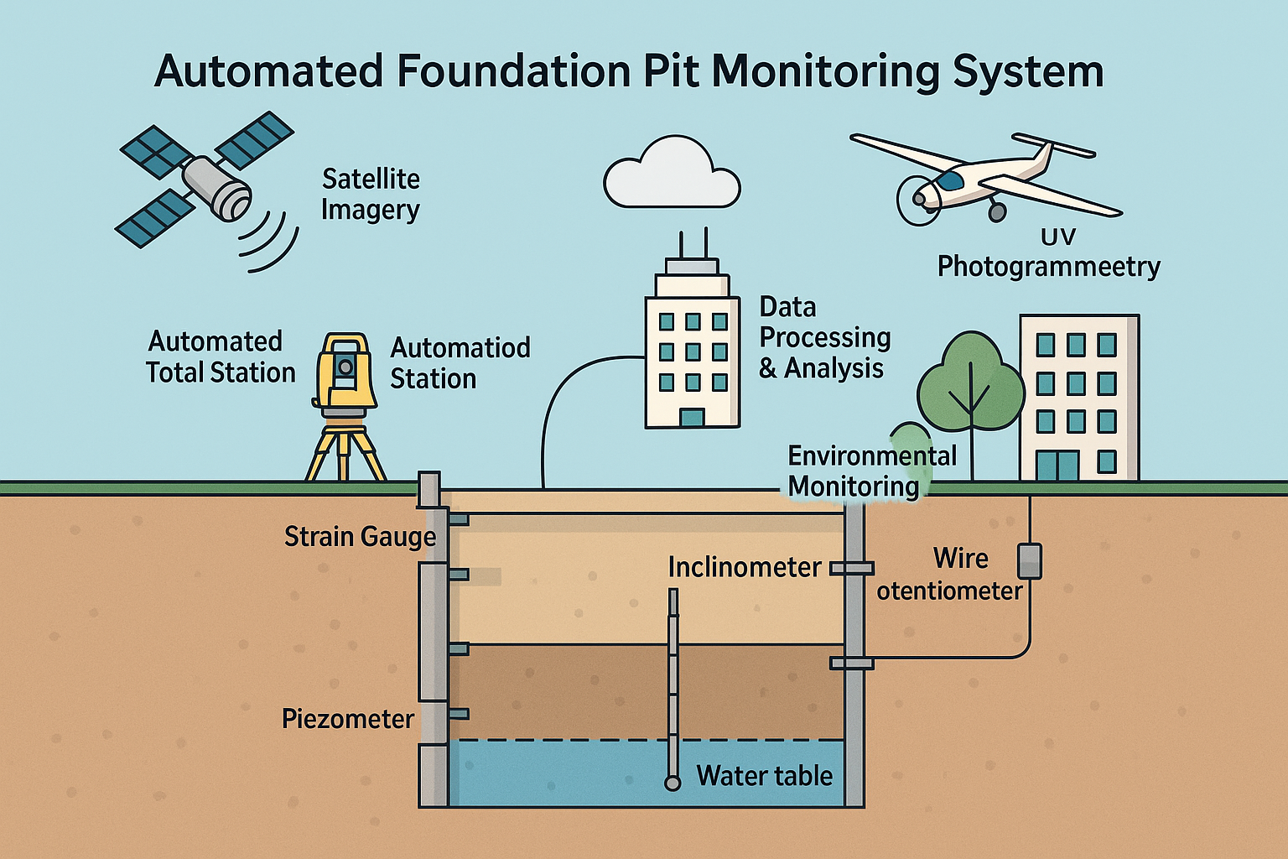
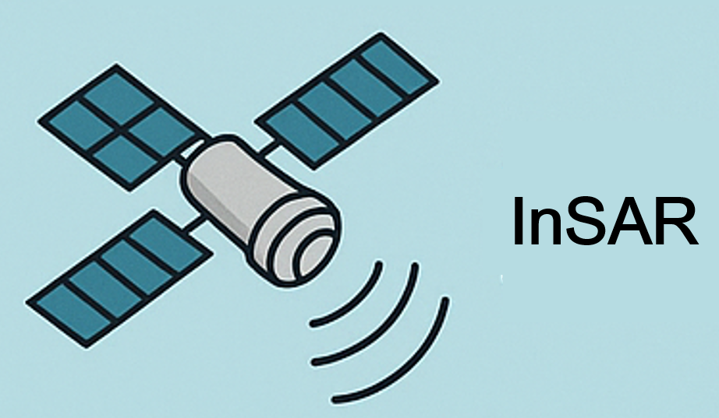
InSAR
UAV
Automated Motorized Total Station
Strain Gauge
Cables and Repeaters
Inclinometer
Piezometer
Water level indicator

Slide 3

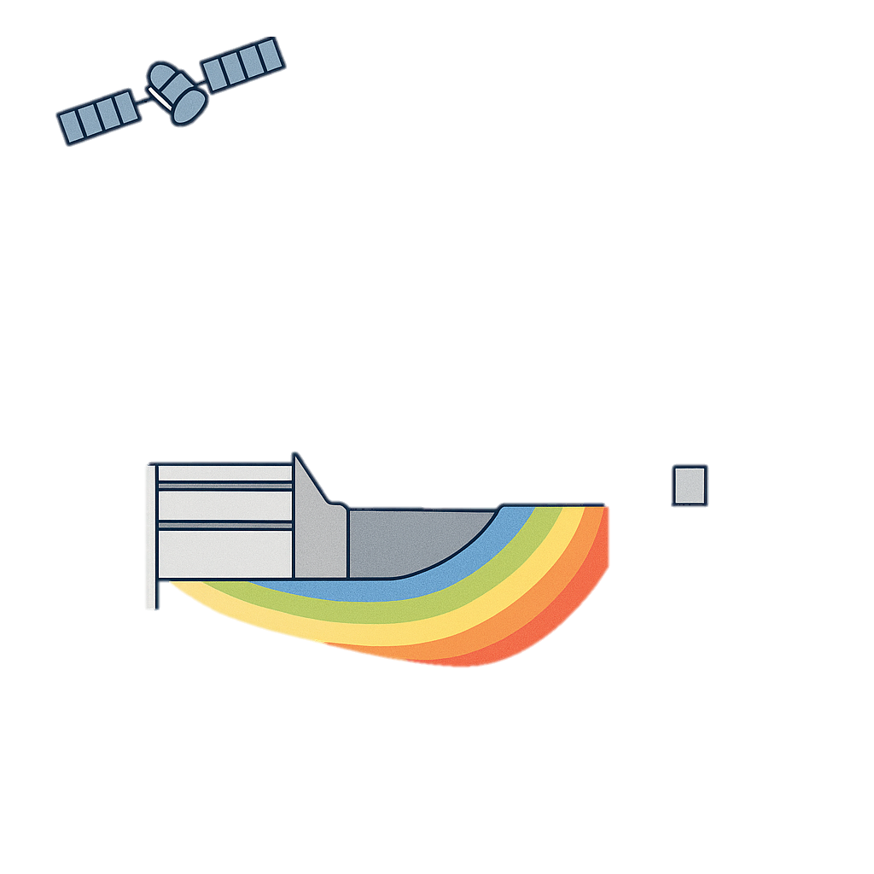

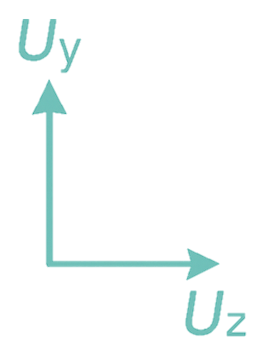


Slide 4
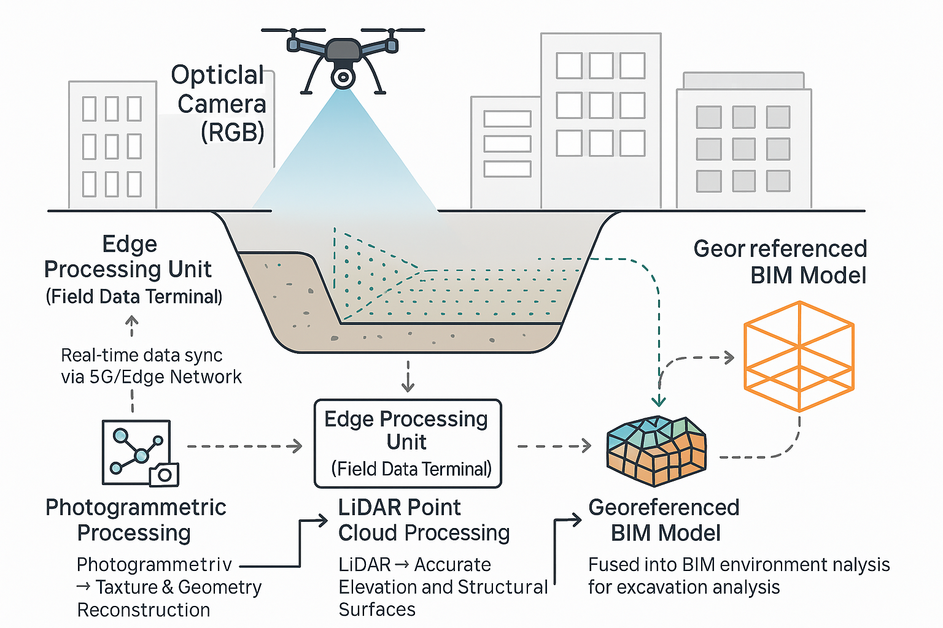

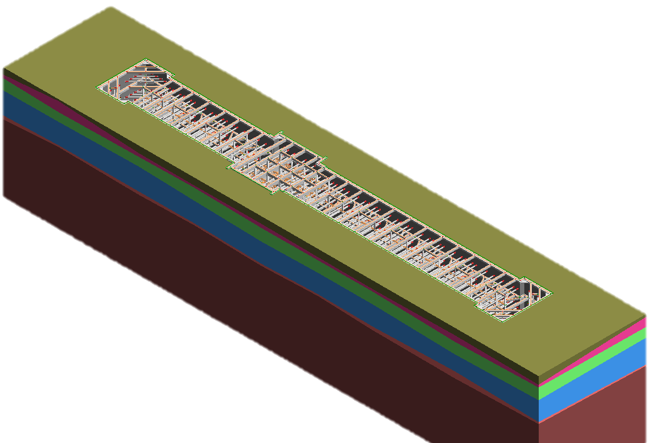
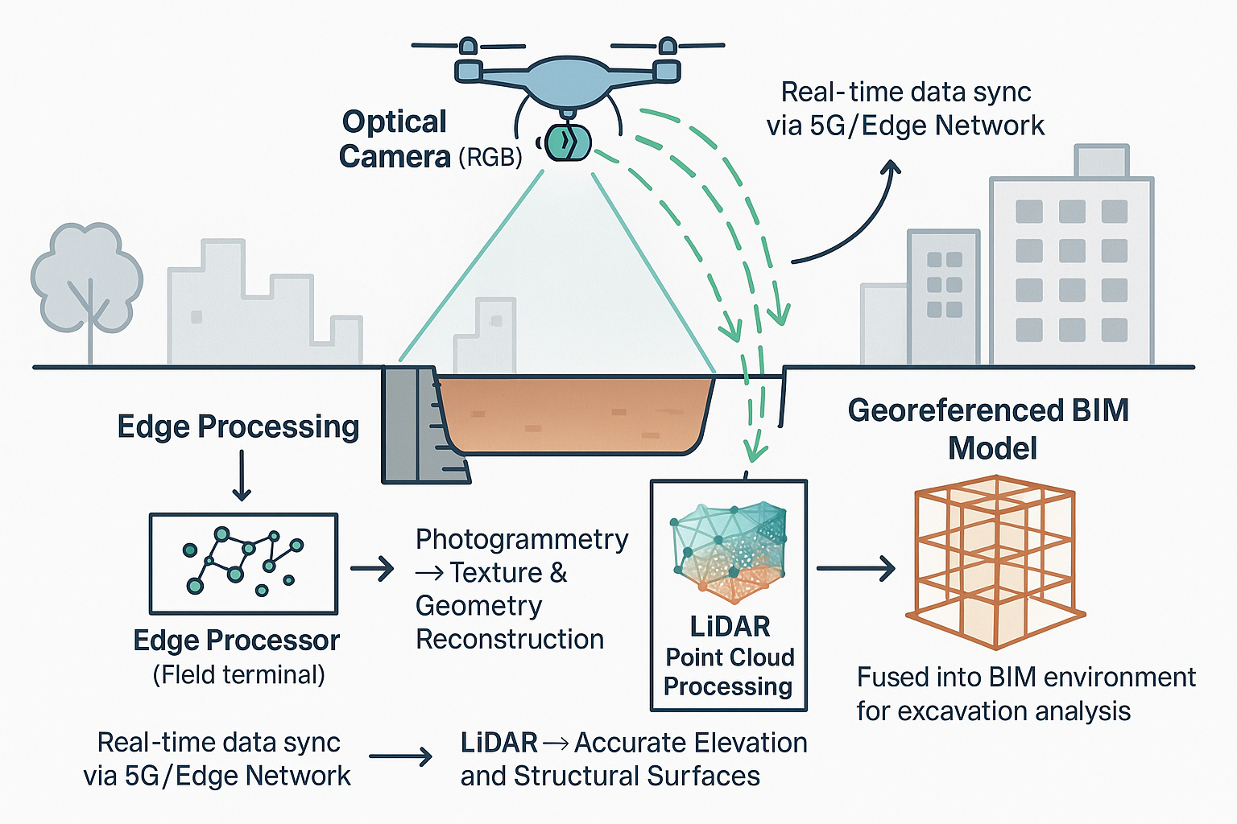
Optical camera & LiDAR
Excavation
Georeferenced BIM model
Photogrammetric Processing
Photogrammetry→
Texture and Geometry Reconstruction
Data Processing
Real-time data sync via LTE/5G/Edge network
SfM: Structure-from-Motion
MVS: Multi-view Stere
ICP: Iterative Closest Point
NDT: Normal Distributions Transform
…
(Field data terminal)
3D Reality Mesh
& Point Cloud
LiDAR Point Cloud Processing
LiDAR→Precise elevation and structural surfaces
Fused into BIM environment
for excavation analysis
LiDAR→Precise elevation and structural surfaces

Slide 5
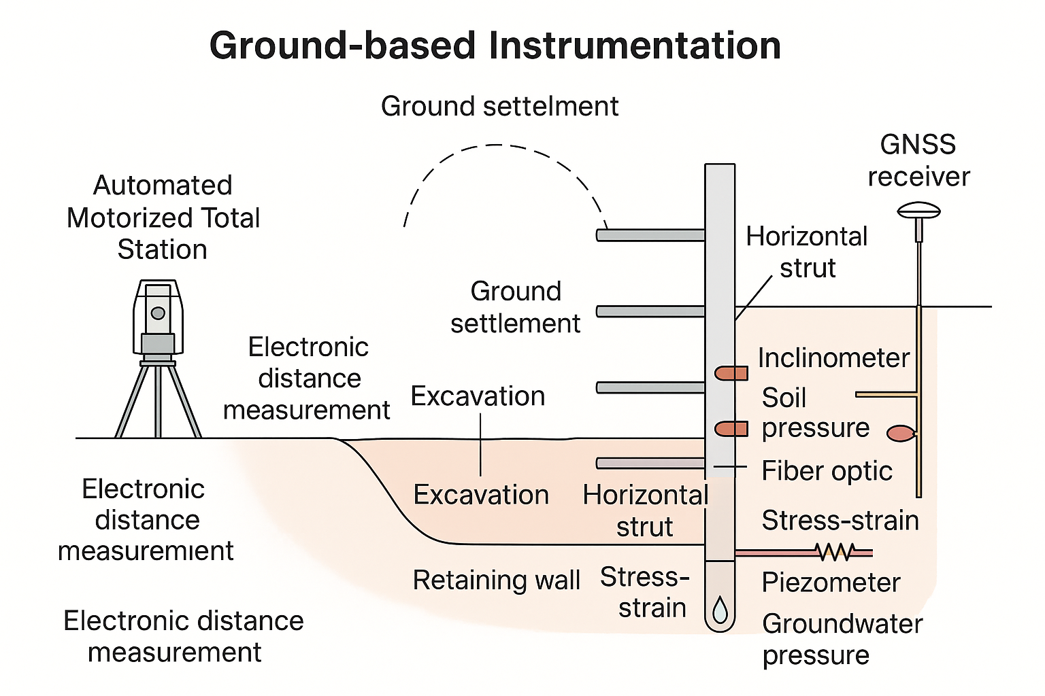
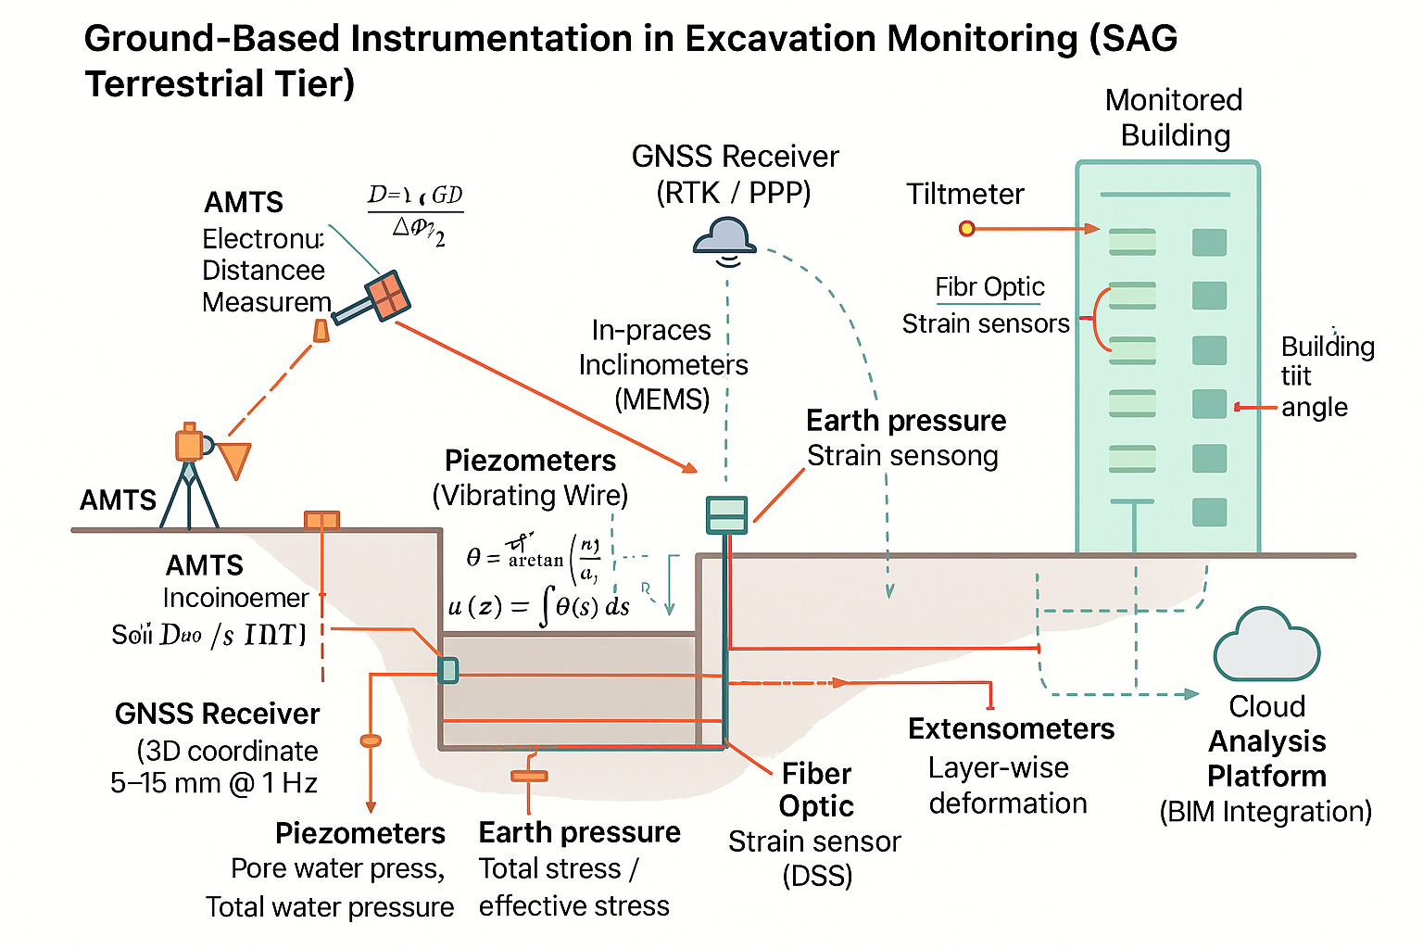
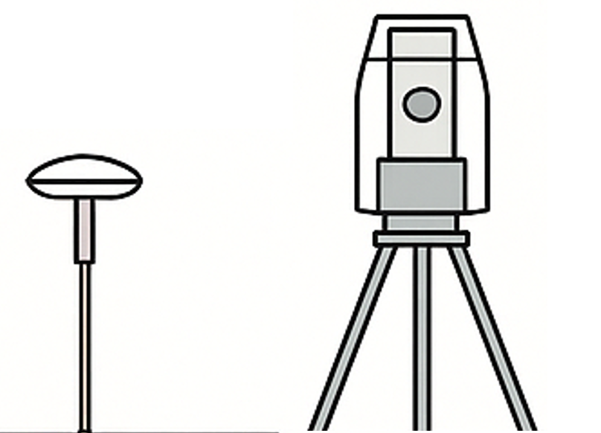

Tiltmeter
Inclinometer
Horizontal deformation of the wall
GNSS receiver
Displacement
Inclinometer
Fiber Optic
Strain
Retaining wall
Automated Motorized Total Stations
Displacement
Stress-strain
Excavation
Soil pressure
Inclinometer
Deep soil displacement
Static level instrument
Subsidence and Uplift
water level indicator
& Pore water press indicator

Slide 6
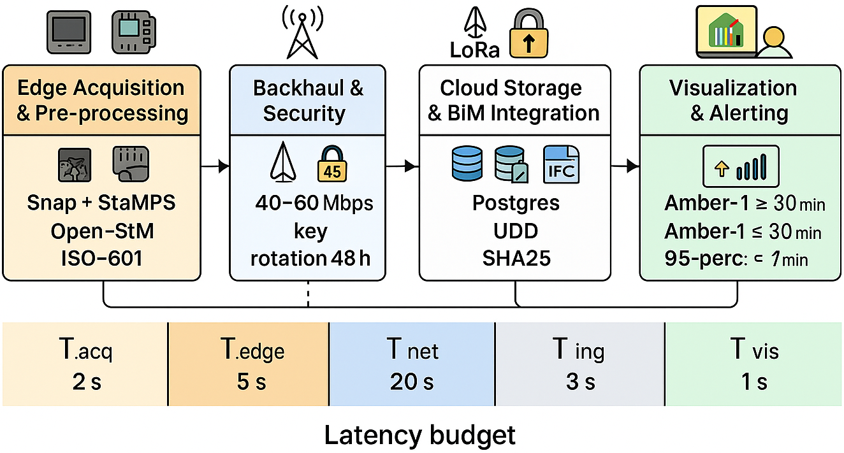
Edge Acquisition & Pre-processing
Backhaul & Security
Cloud Storage & BIM Integration
Visualisation & Alerting
Snap+StaMPS
Open-SfM
ISO-8601
5 G low-latency LoRaWAN redundancy
AES-256-GCM encryption
PostgreSQL(TimescaleDB)
MinIO
IFC 4.3
interactive dashboard
rule-based alerting
closed-loop response
T_{acq}
2 S
T_{edge}
5 S
T_{net}
20 S
T_{ing}
3 S
T_{vis}
1 S
Latency budget

